Slide 1
Semen collection
5th Stage

Slide 2
1-Vaginal Method
Semen collection from vagina after natural ejaculation.
-Advantage:-semen satisfactory for evaluation.
-Disadvantage:-semen contaminated with fluids from female tract.
1-A-Siphoning M.
Follows normal copulation, pipette inserted into the vagina
after ejaculation to siphon out semen

Slide 3
1-B-Spooning M.
Follows normal copulation, long-handled sterile
spoon used to dip semen from floor of anterior vagina
1-C-Sponge M.
Sponge placed in vagina before copulation

Slide 4
2-Massage m.
(In large animals),by transrectal massage of the ampulla ,vesicular g. and prostate g.
Advantage:-bull easy to handle, not excited
Disadvantage :-poor quality semen,higher incedence of bacteria.
.

Slide 5
3-Urethral fistula m.
Tube placed under the anus connected to urethra ,sperm collection at a time of copulation.
Advantage:-experimentation ,pure sample.
Disadvantage:-requires exacting surgery.

Slide 6
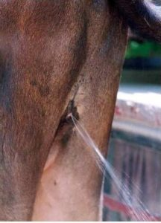

Slide 7
4-Artificial Vagina(AV).
Advantages:--
uncontaminated and natural stage.
-it is free from the extraneous secretion.
-the viability of the sperm is better.
-no female is needed if dummy is a success.
Disadvantages:-
must simulate normal or best temperature ,pressure , lubrication and position for optimum male response.
-Animal must be treated as individuals since they differ.

Slide 8
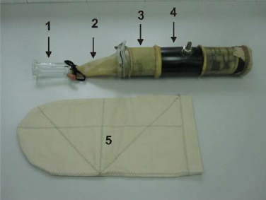
4-Cylinder
3-Inner sleeve
5-Insulating protector
1-Collection tube
2-Cone

Slide 9
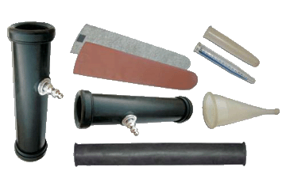
Cylinder
Insulating protector
Water bath
Collection tube
Cylinder
Cone
Inner sleeve

Slide 10
Longitudinal section of an Artificial Vagina(AV)

Slide 11
5-Electro ejaculation :-
Electrode inserted into the rectum to stimulate ejaculation ,
not widely used with stallion .
*Advantages:
1-collect semen without sexual response from the male.
2-collect from males unable to copulate
3-female in estrus not need
*Diadvantages:
1-Equipment cost
2-contaminated with urine
3-danger for collector and male

Slide 12
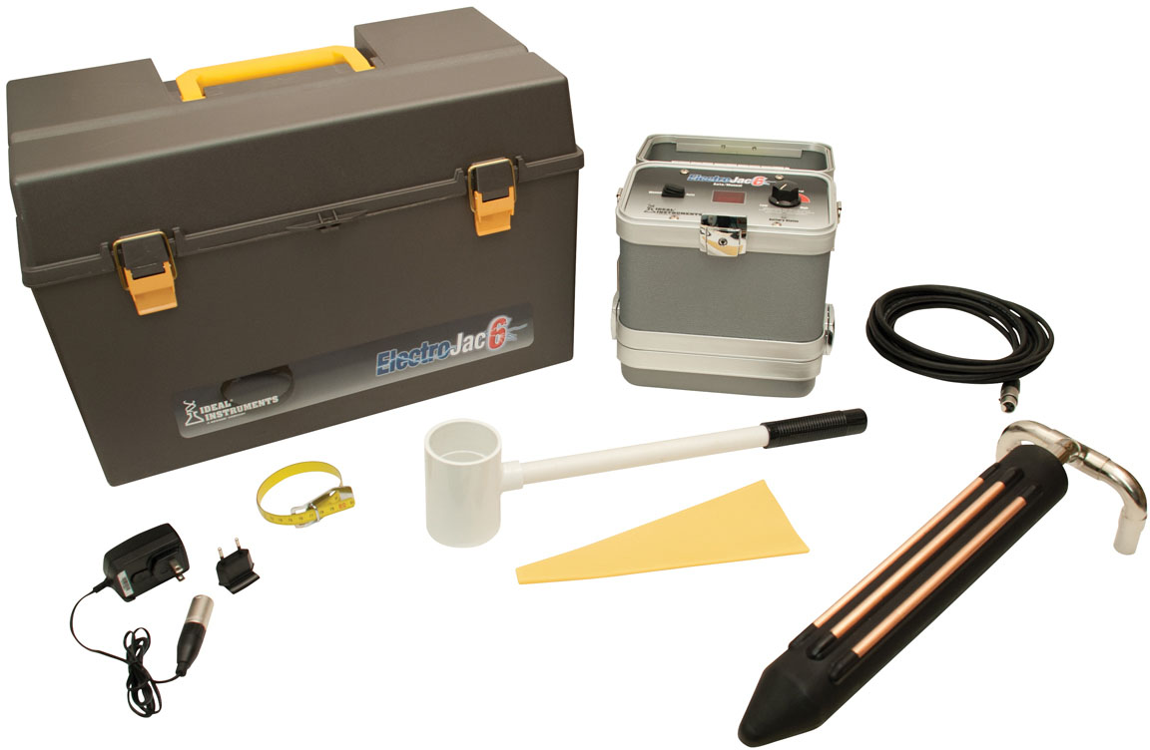

Slide 13
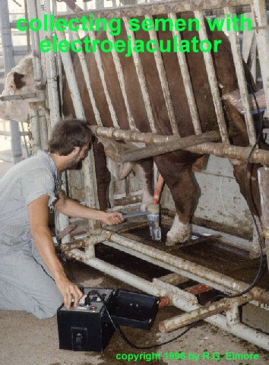

Slide 14
